Slide 1
Advanced OSINT & Introduction to Maltego
Using Github Tools & Basic Maltego Investigations

Slide 2
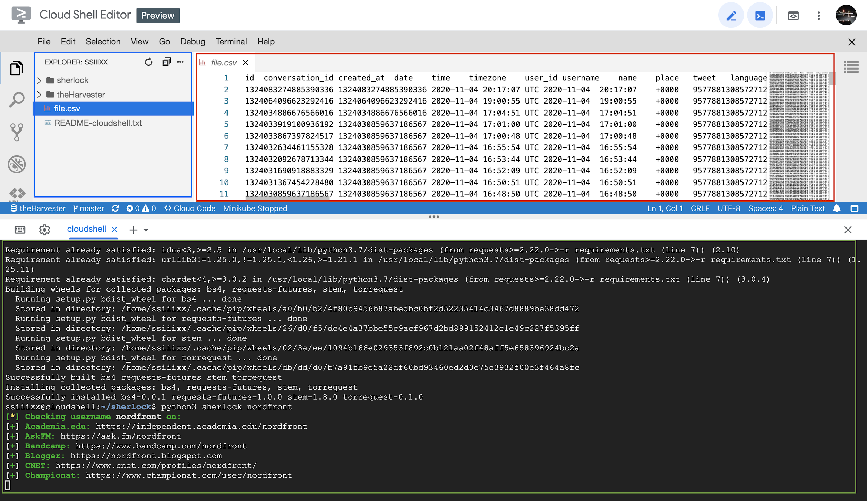
Google Cloud Shell
The Cloud Shell interface is split into three sections:
Blue: File system explorer
Red: File preview
Green: Console interface

Slide 3
Debian Linux Basics
For getting around:
ls - list the contents of the folder you are in
cd - change directory (move to another folder),
cd .. - will take you back up one directory
git clone - download a program from Github to your computer
python3 - programming language of the tools we’re working with

Slide 4
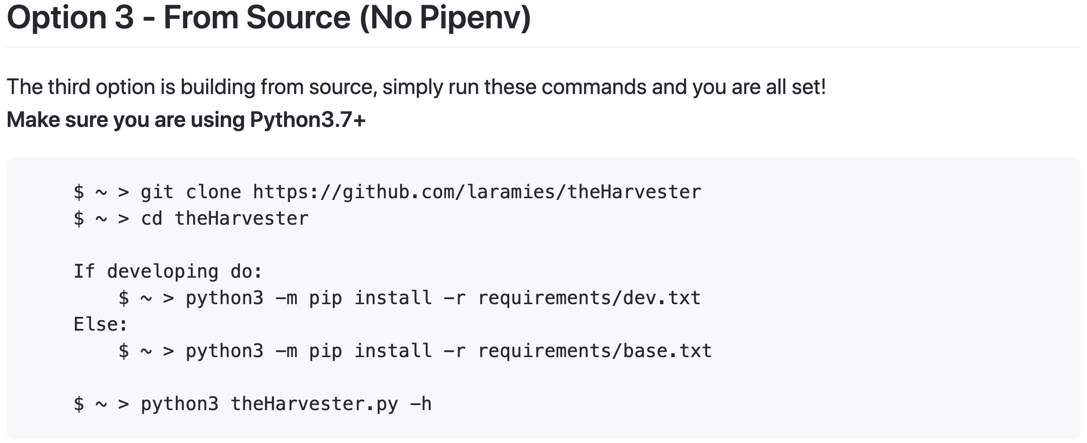
Installing a Program
Installing programs will be done from Github, you can see instructions for our first program here:
https://github.com/laramies/theHarvester/wiki/Installation

Slide 5
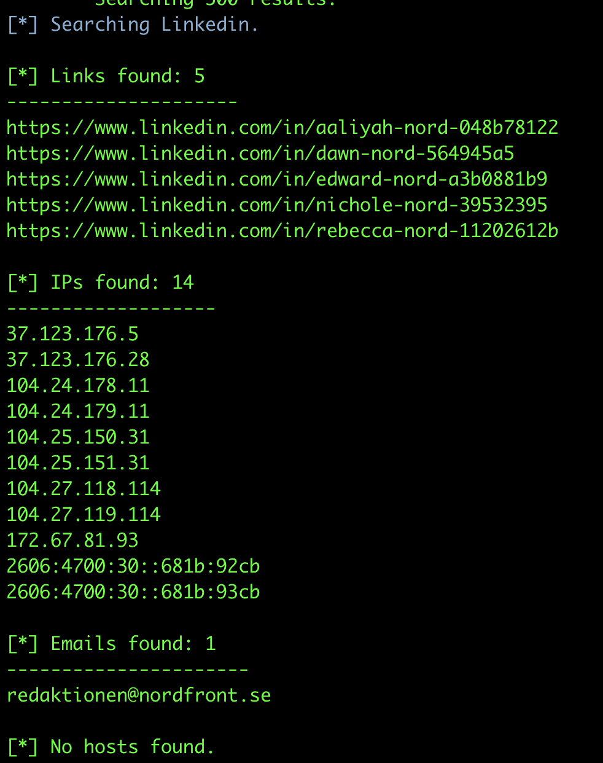
First program: TheHarvester
This program discovers email addresses, and profiles a domain to find more information about it.
We can see the results on the screen, or save them as a file.

Slide 6
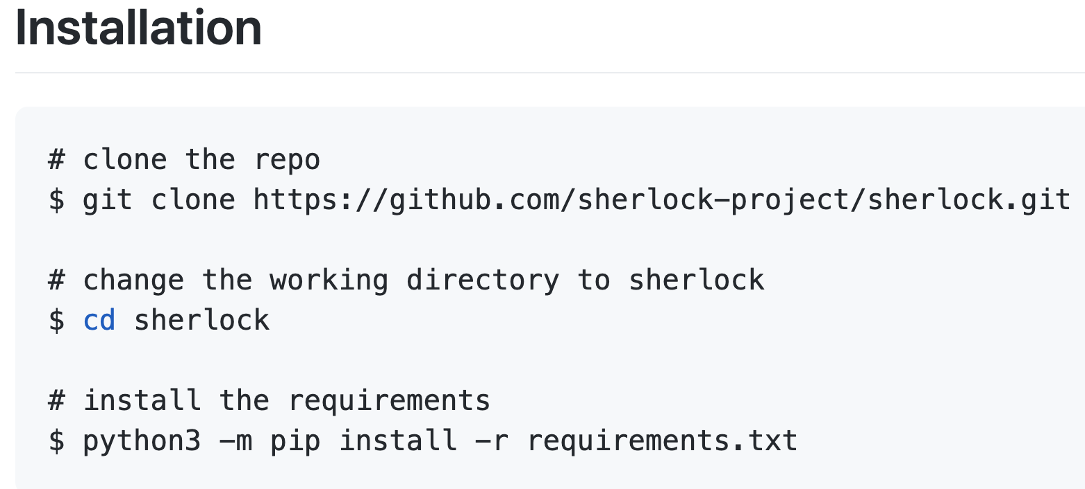
GitHub Basics
To install a program from Github:
Go to the Github page of the program you want to install
Open a terminal on your computer (the cloud shell) and use the git clone command to download the program
Use the cd command to move into the folder that holds the downloaded program
Follow the installation instructions on the Github page

Slide 7
Installing Sherlock
Our first tool to use will be Sherlock, we’ll install it with the following command:
git clone https://github.com/sherlock-project/sherlock.git && cd sherlock && python3 -m pip install -r requirements.txt

Slide 8
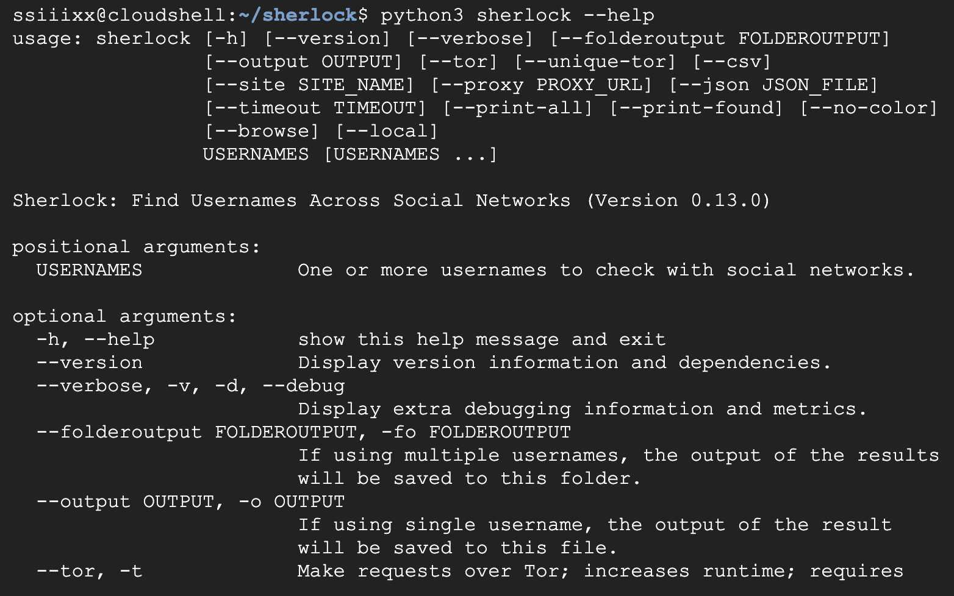
Read the Help File
Look at available commands using the following command:
python3 sherlock --help

Slide 9
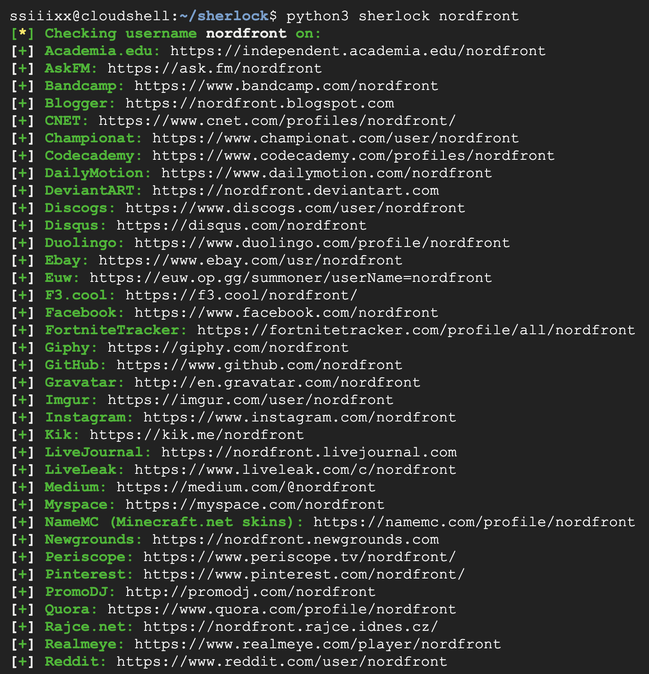
Screen Name Search
Run a search for a screen name with the following command:
python3 sherlock nordfront
Make sure to run cd .. before we install the next program!

Slide 10
Installing TheHarvester
You can install TheHarvester by pasting the following commands into your terminal:
git clone https://github.com/laramies/theHarvester
cd theHarvester
python3 -m pip install -r requirements/base.txt
Or, you can do it all in one command:
git clone https://github.com/laramies/theHarvester && cd theHarvester && python3 -m pip install -r requirements/base.txt

Slide 11
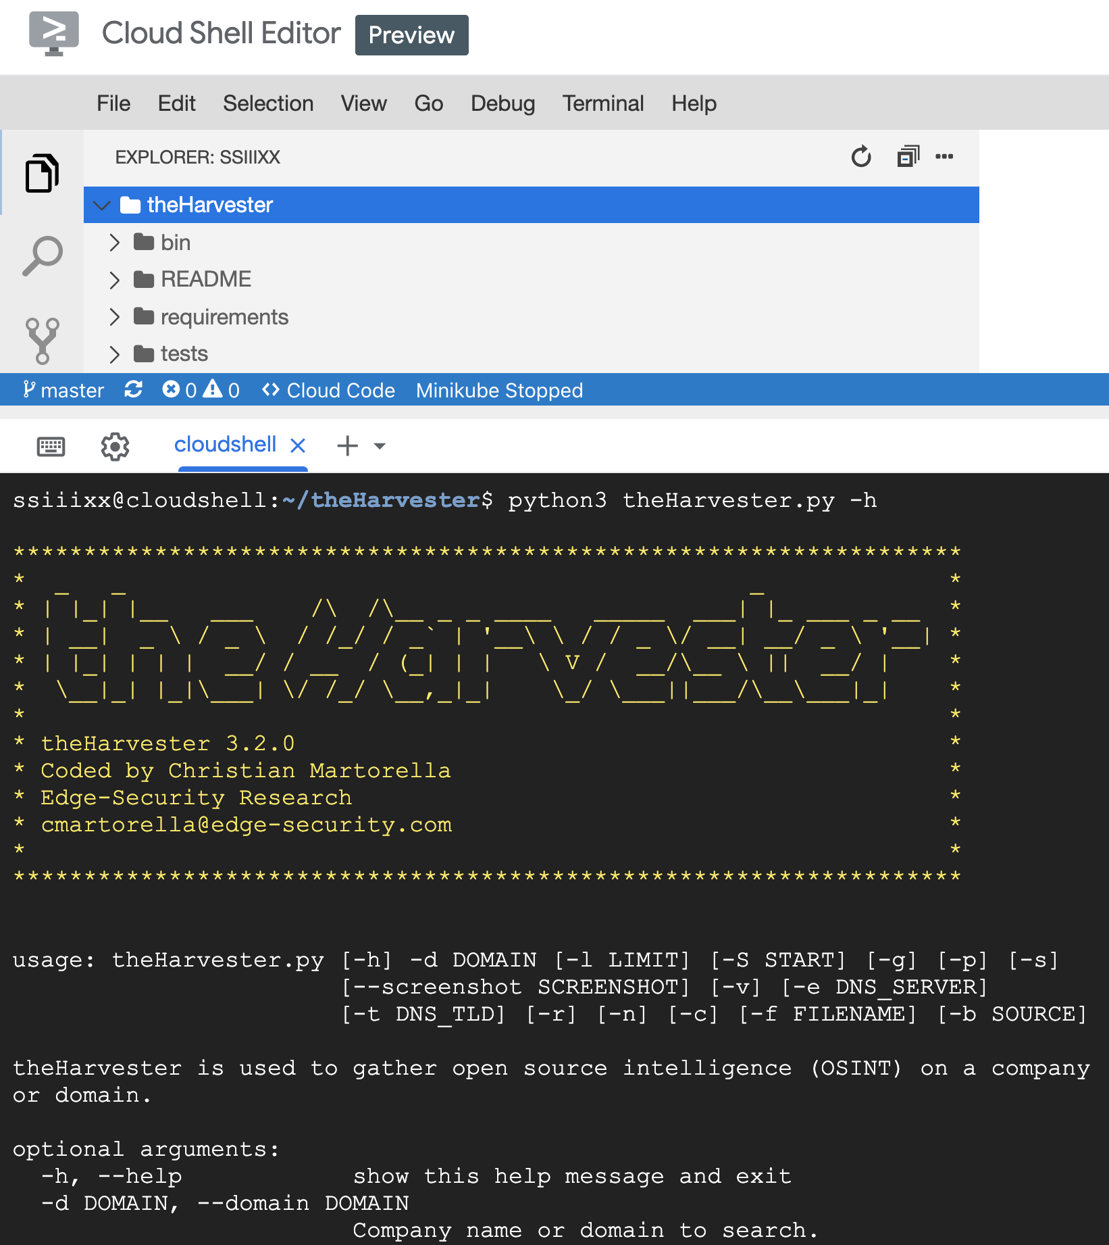
Read the Help Menu
To see the available options, run the following command:
python3 theHarvester.py -h

Slide 12
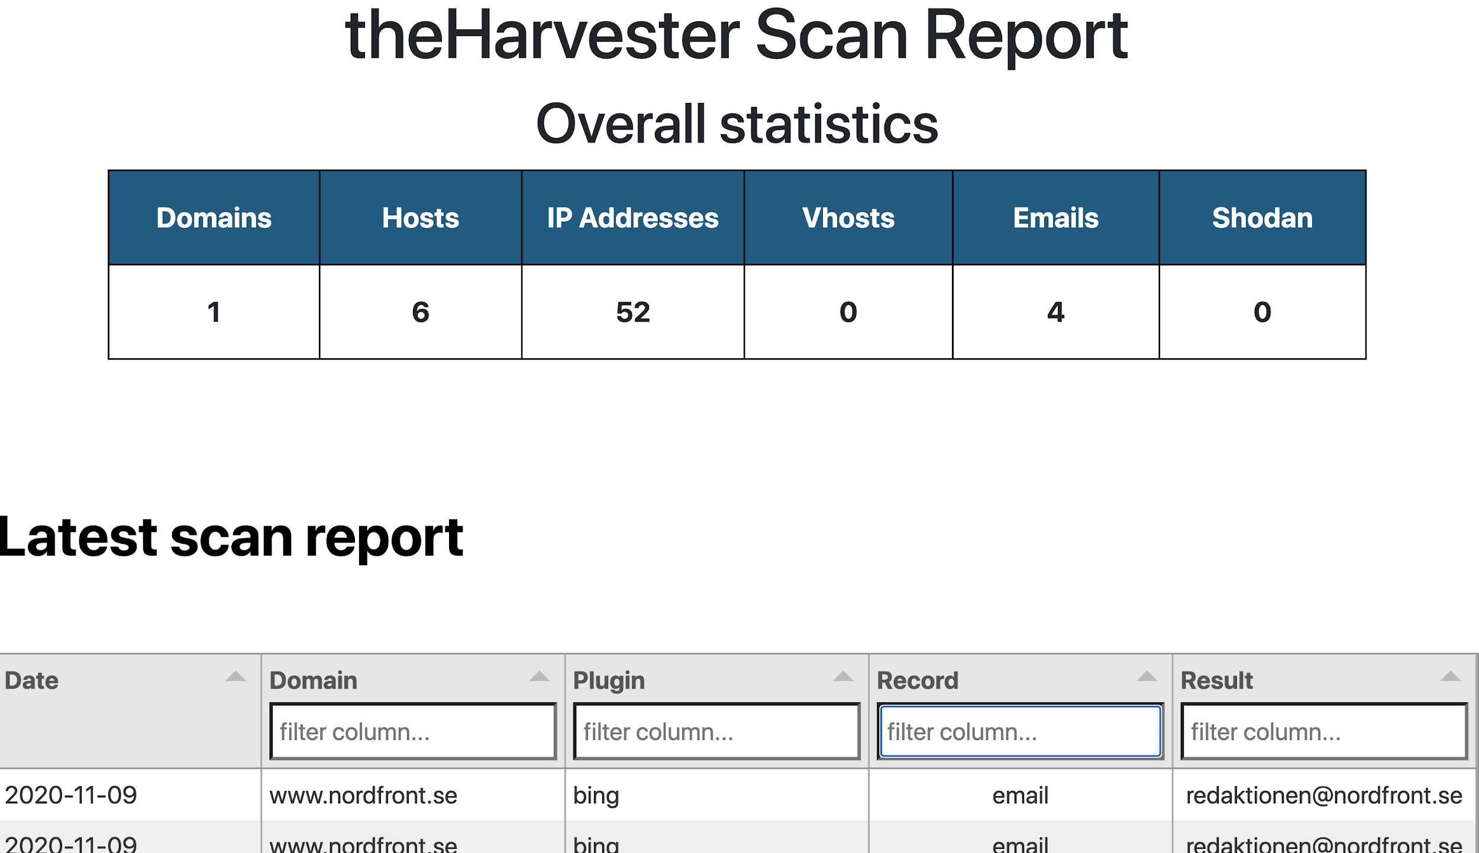
Simple Search
theHarvester.py -d www.nordfront.se -b all -f nordemail.html

Slide 13
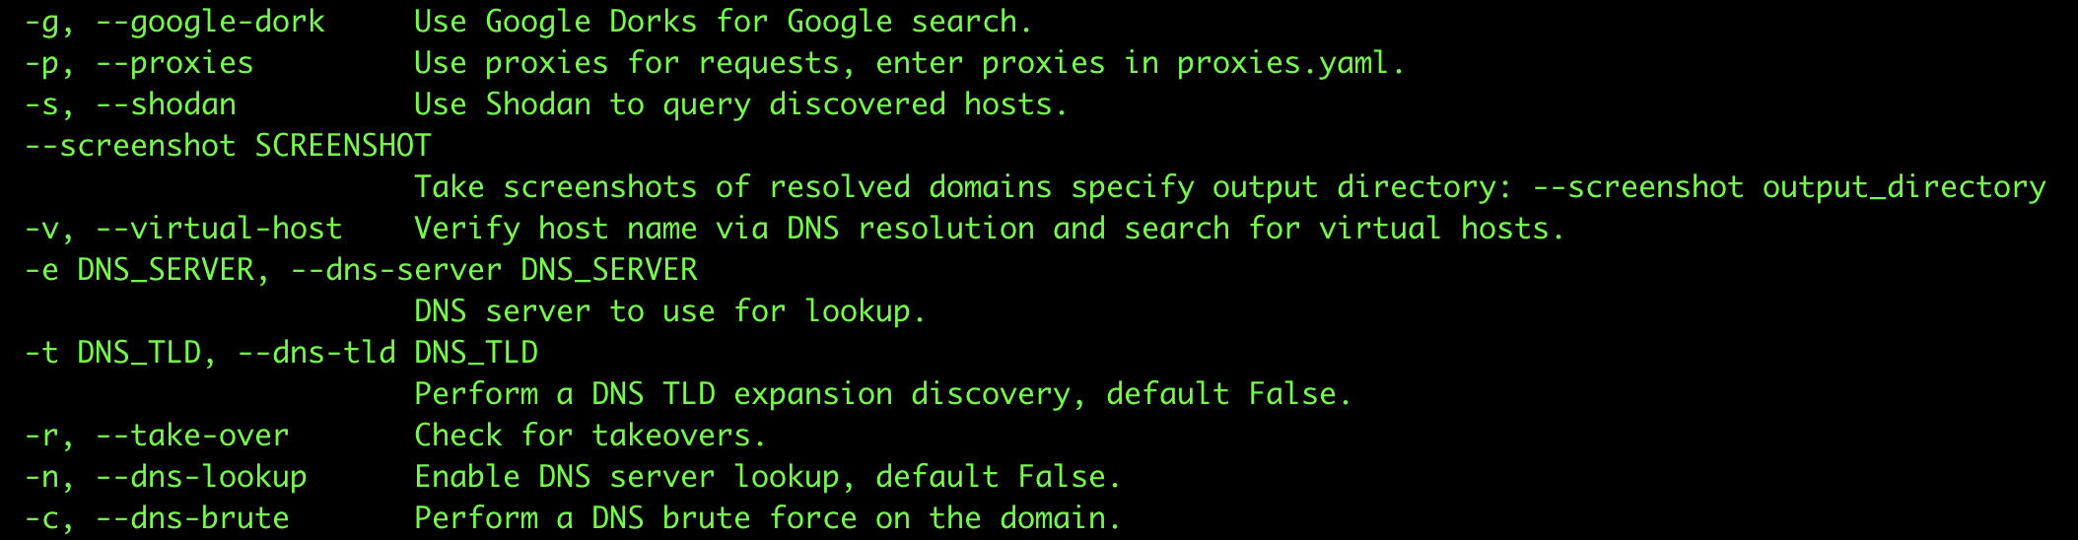
Let’s Use More Arguments
After looking at the help file, let’s try using more of the arguments to give us more information:
python3 theHarvester.py -d www.nordfront.se -g -v -n -c -b all -f nord.html

Slide 14
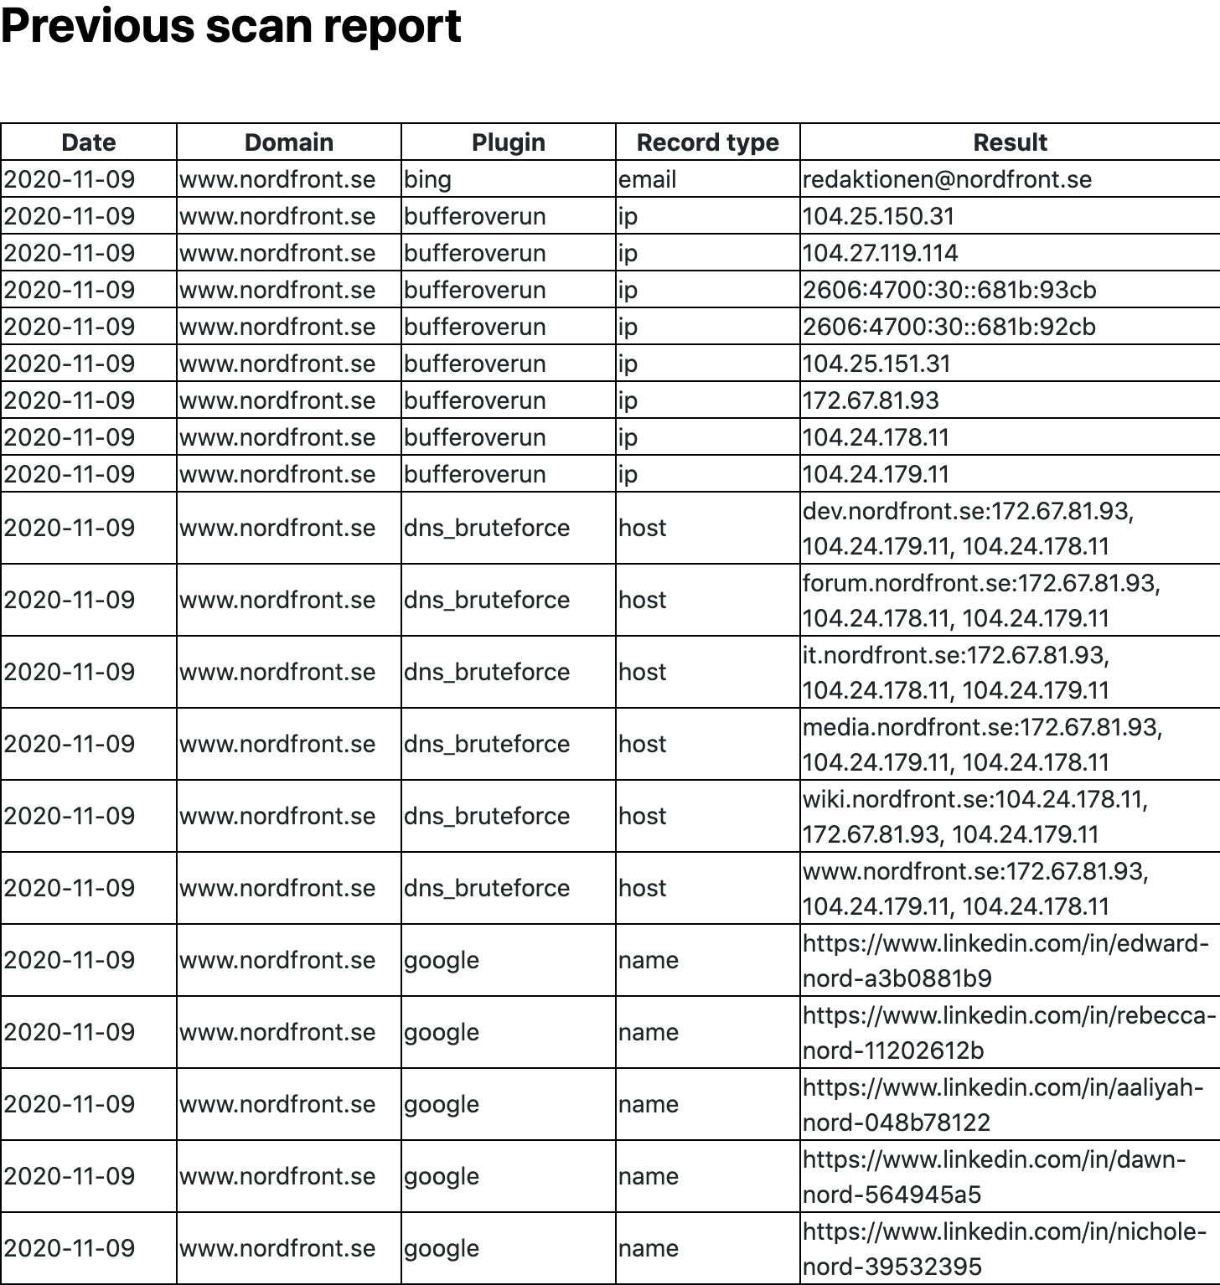
Sample Report
You can download & open a sample report in your browser: https://raw.githubusercontent.com/skickar/OSINT2020/main/nord.html

Slide 15
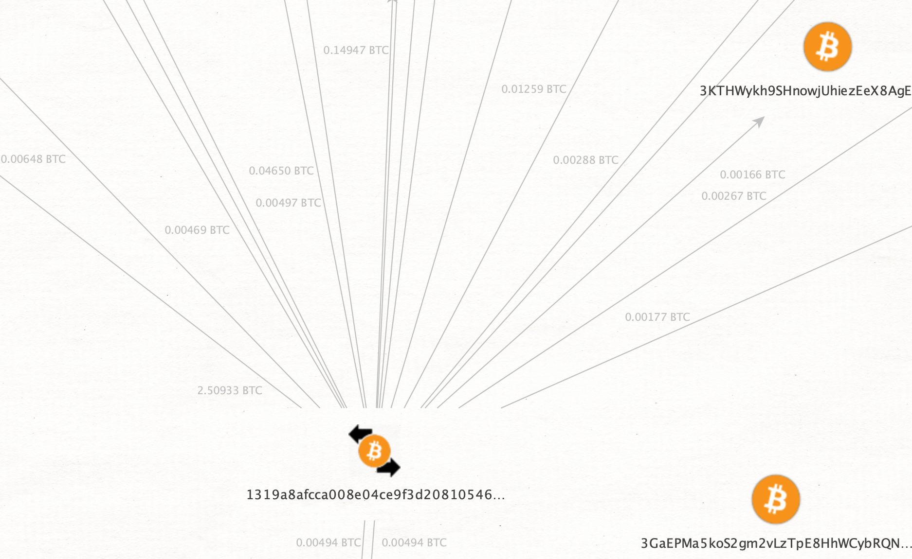
Maltego Basics
Maltego is an advanced OSINT tool designed to make a few parts of OSINT more easy:
Visualizing data
Using API’s to pull in new data
Organizing relationships between data points

Slide 16
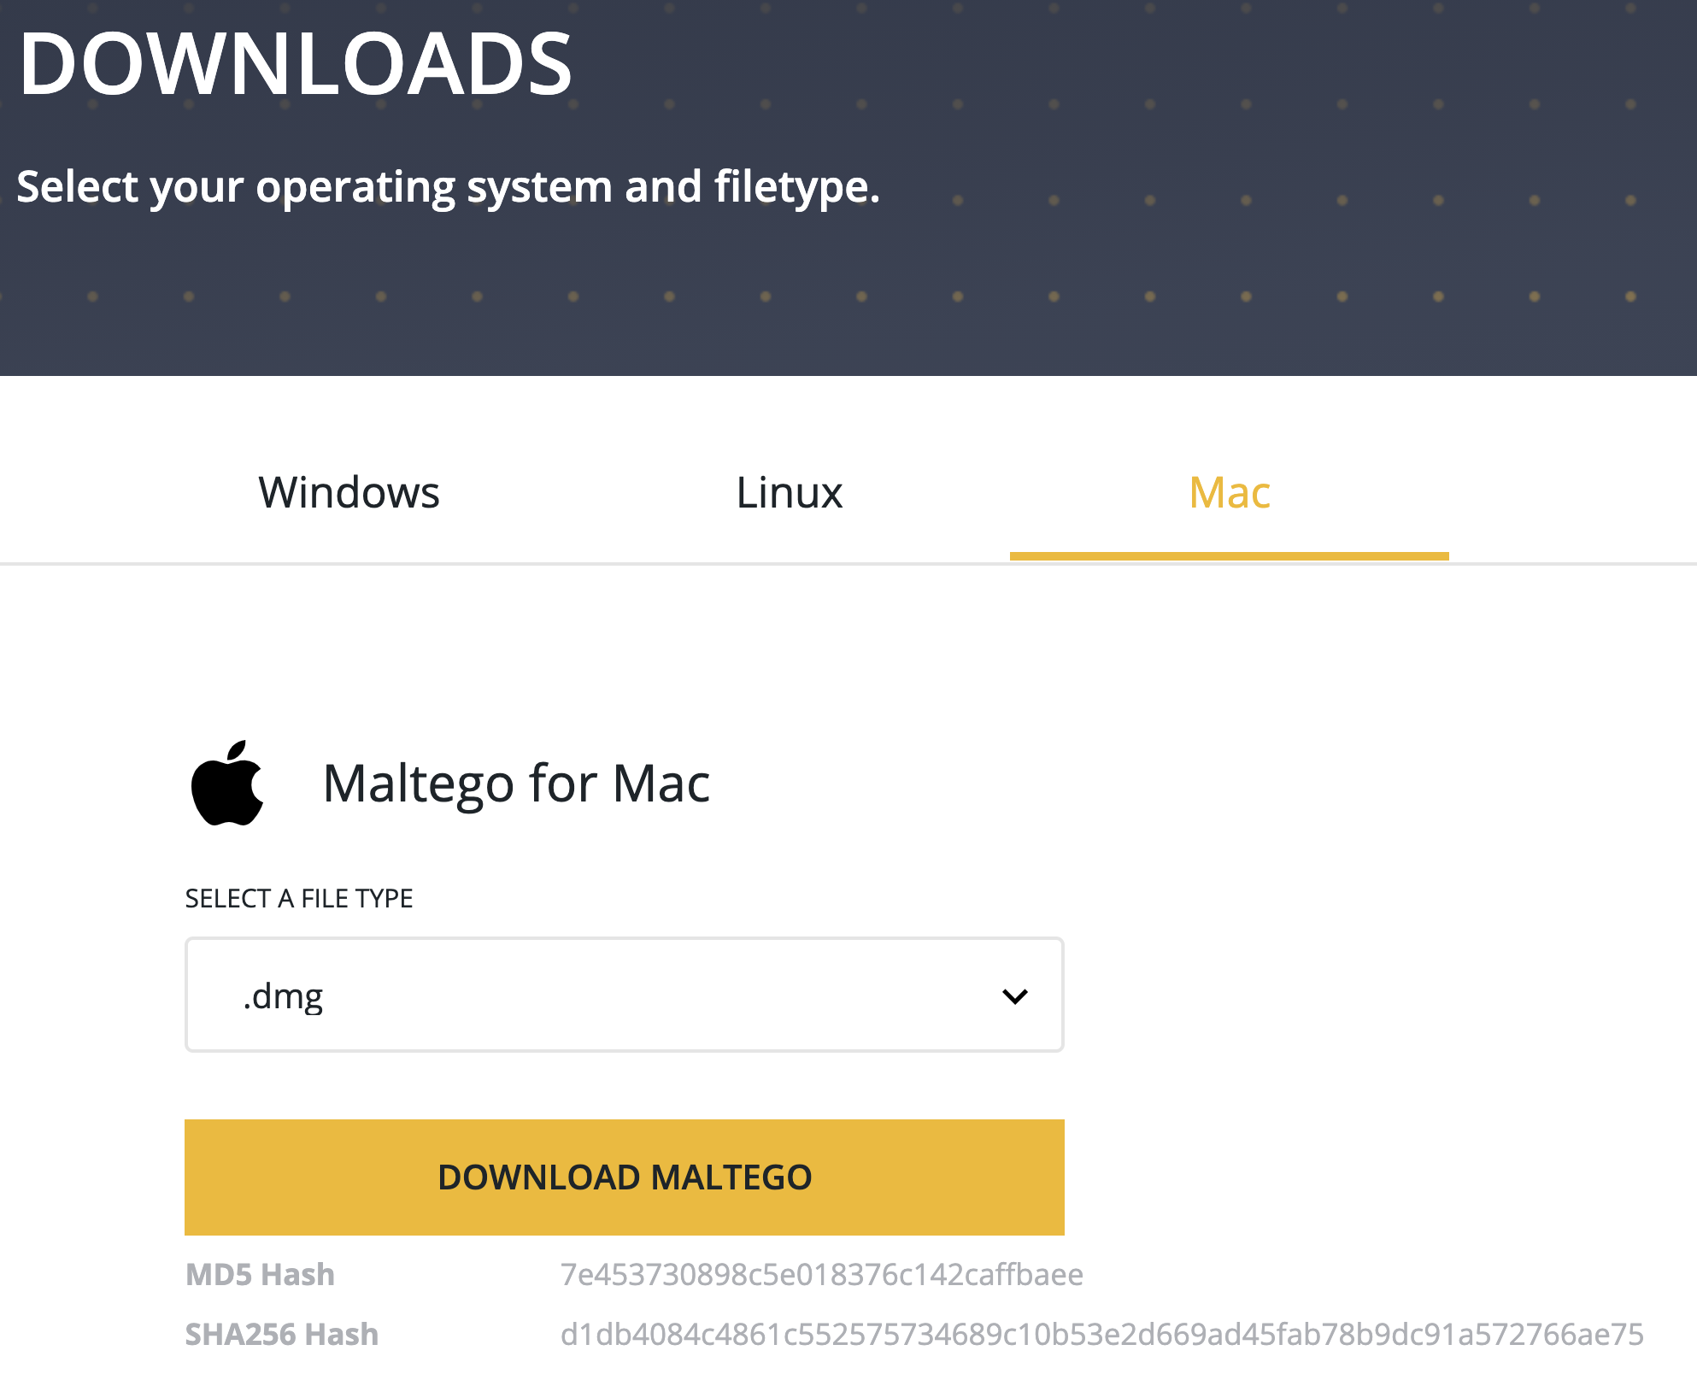
Download Maltego
Navigate to the following URL to download Maltego for your operating system:
https://www.maltego.com/downloads/

Slide 17
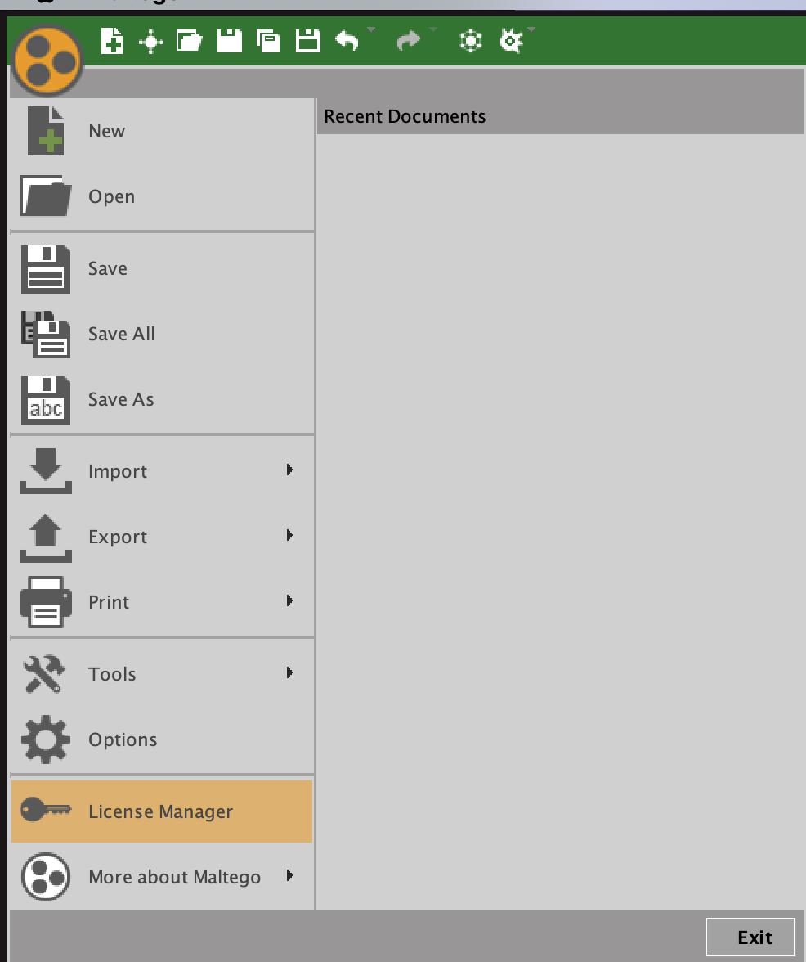
Install Your License Key
Included with this class, you should have received a Maltego Classic license key.
Input your key when Maltego asks for it during the installation, or you can always install the free community edition and add your license in the license manager later.

Slide 18
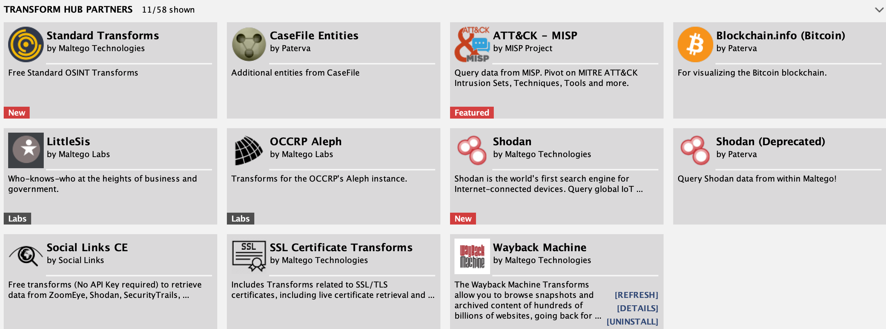
What Are Transforms?
Transforms fetch data and organize it visually, using data types called entities.

Slide 19
Installing Transforms
For our investigations, install the following transforms:
WayBackMachine
Standard Transforms
Blockchain.info
TinEye
OCCRP Aleph
IP Quality Score
LittleSis

Slide 20
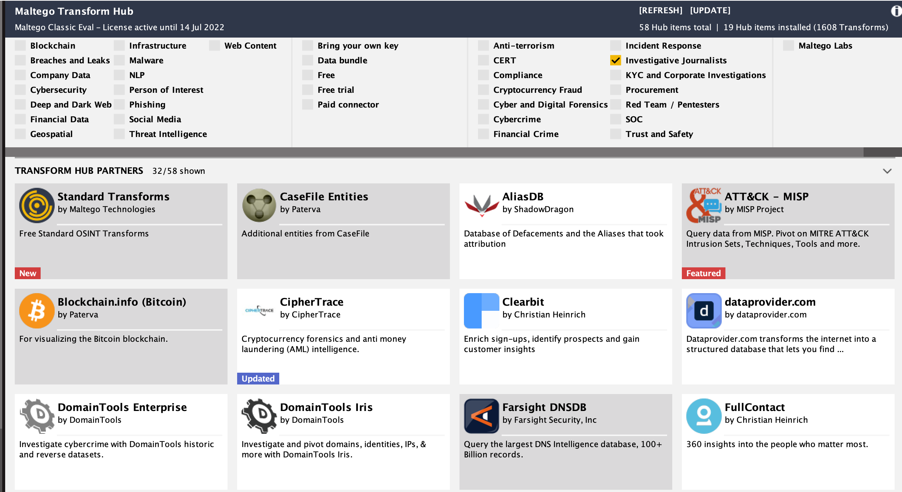
Transforms For Journalism

Slide 21
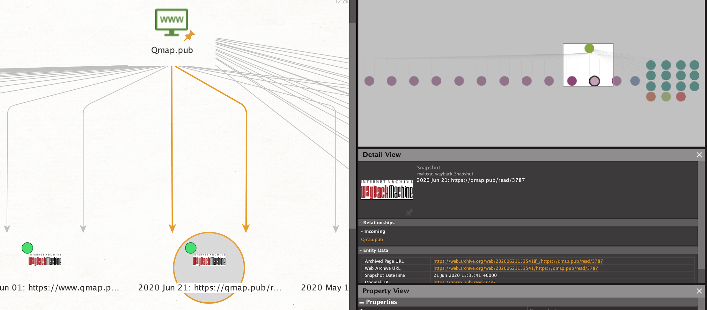
Deleted Website Investigations

Slide 22
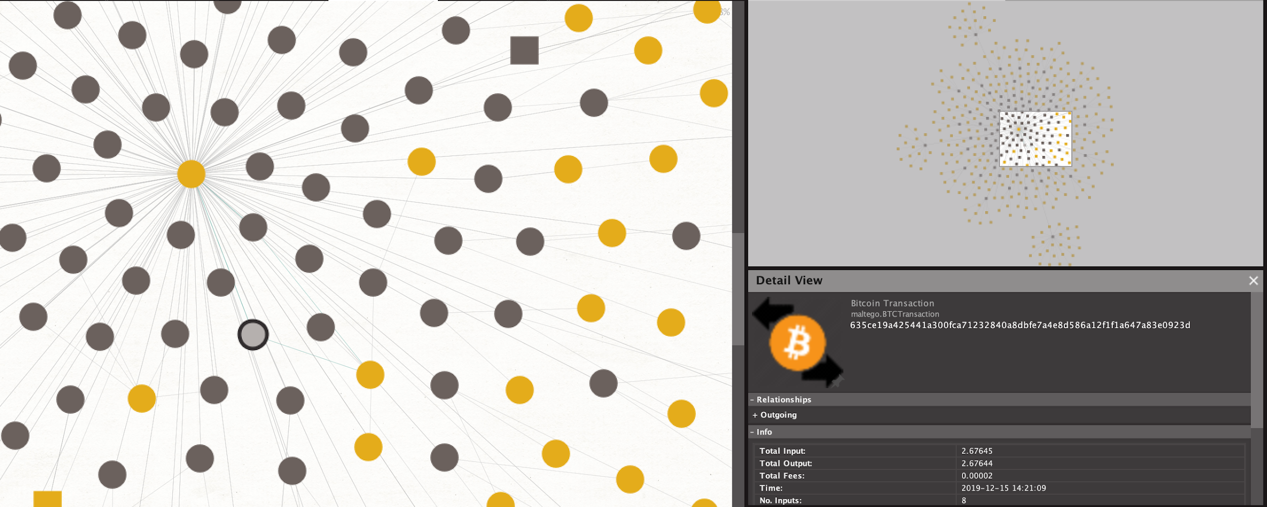
Bitcoin Investigations
Criminal organizations and extremist groups often use Bitcoin to solicit donations.
Using blockchain transforms, we can identify patterns in these organizations moving money and soliciting donations.

Slide 23
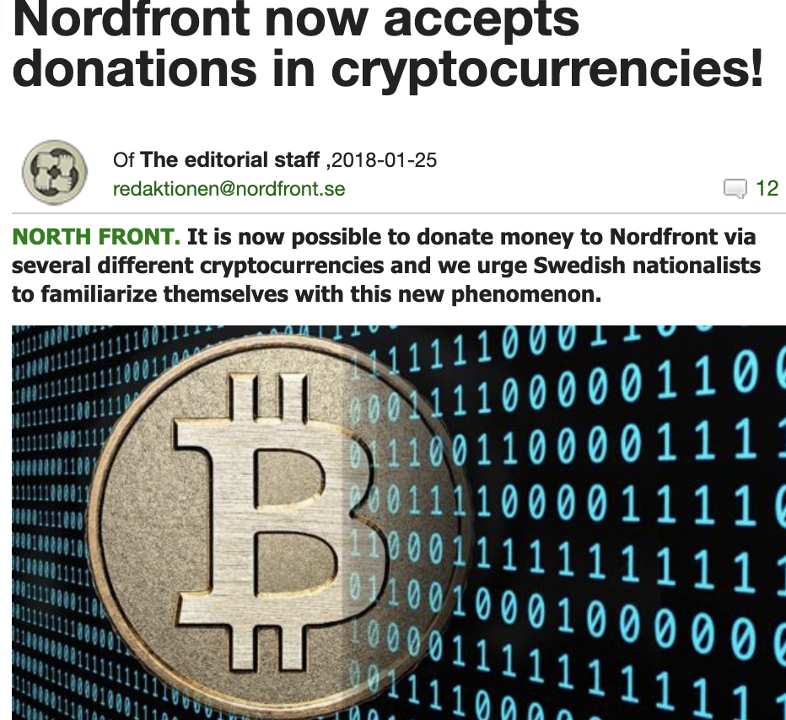
Investigating a Bitcoin Wallet
This neo-nazi organization accepts donations via Bitcoin.
If we want to investigate their donations, and where the money goes, we can use Maltego do to this.

Slide 24
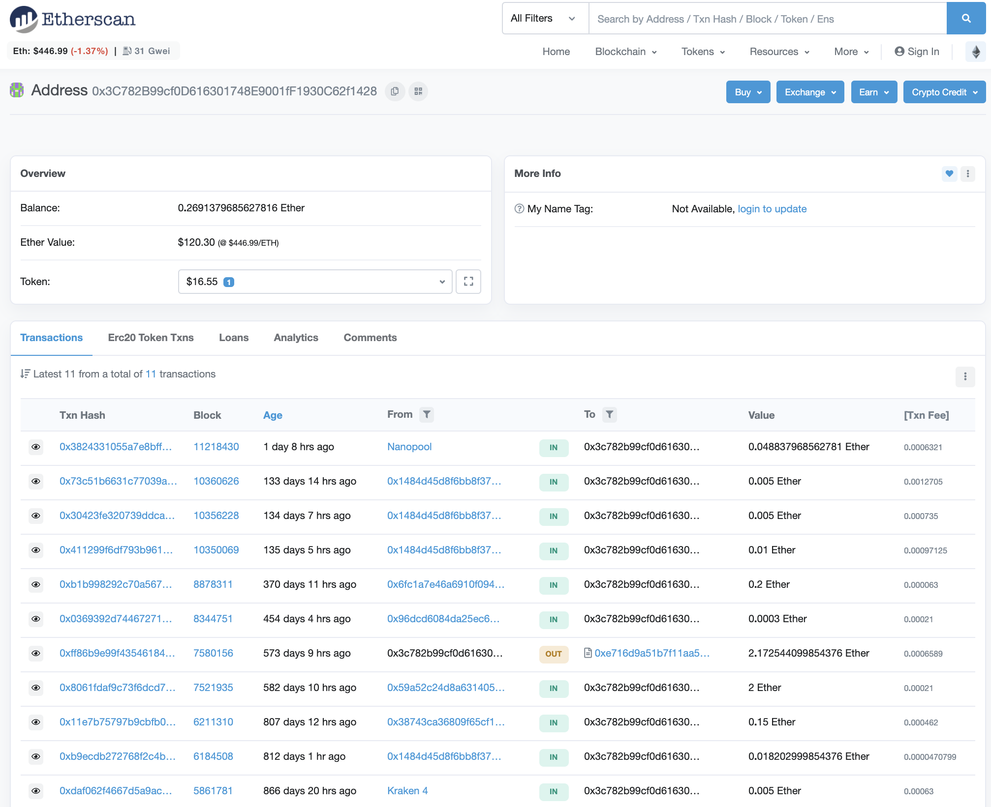
Ethereum
Maltego currently doesn’t support ethereum, but we can use a browser based tool to identify how much this contributes to their fundraising.
https://etherscan.io

Slide 25
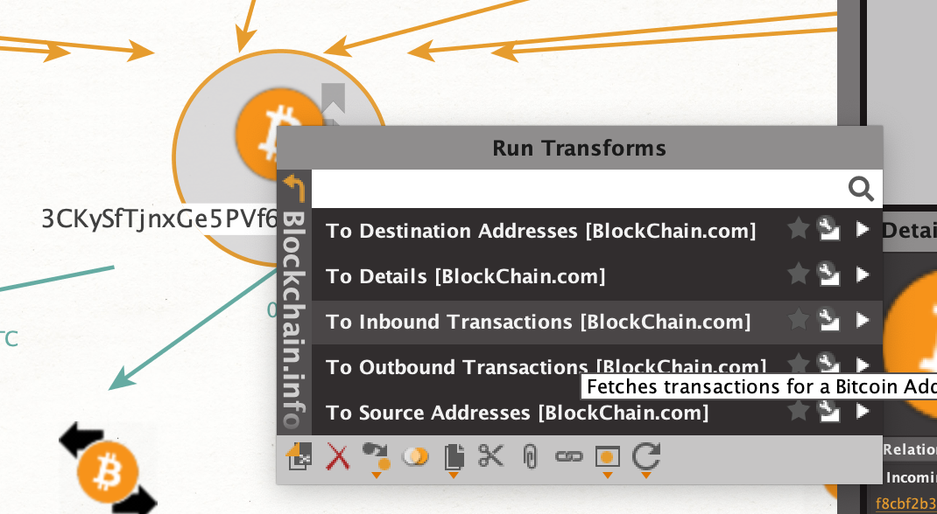
Identifying Incoming Transactions
We can create a bitcoin wallet entity, and add the address of our target.
Then, we run the “inbound transactions” transform to show payments to this wallet.

Slide 26
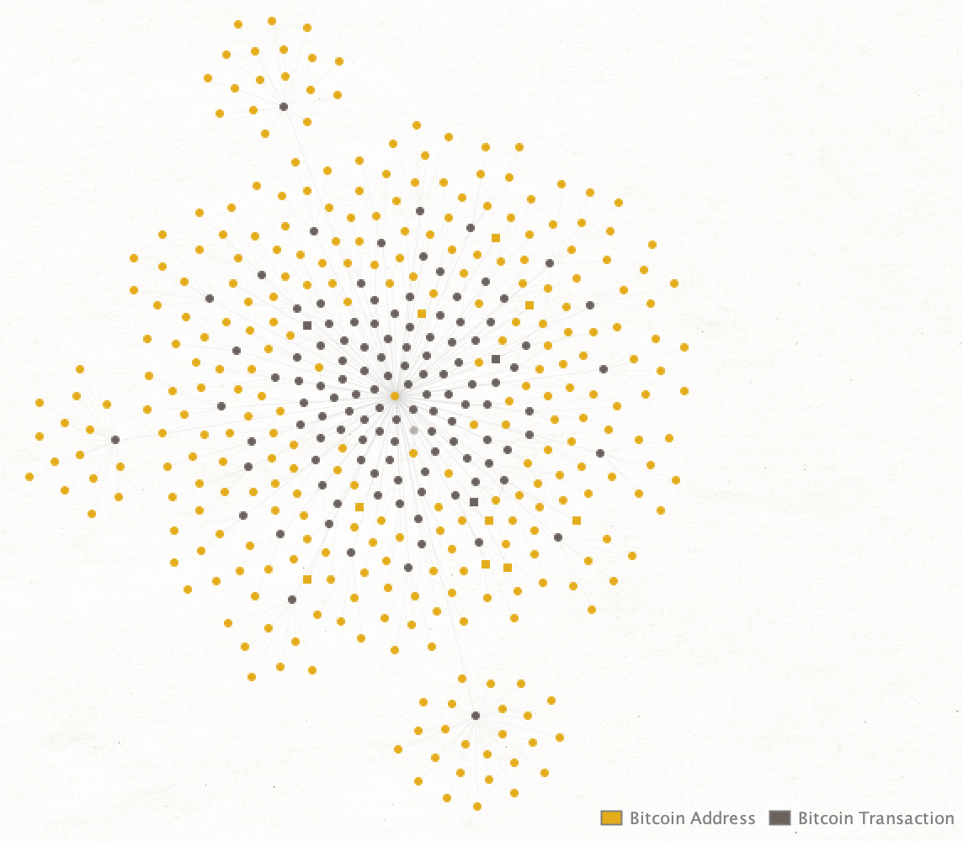
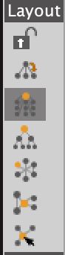
Incoming Donations
By adjusting the layout, we can make it easier to see patterns.

Slide 27
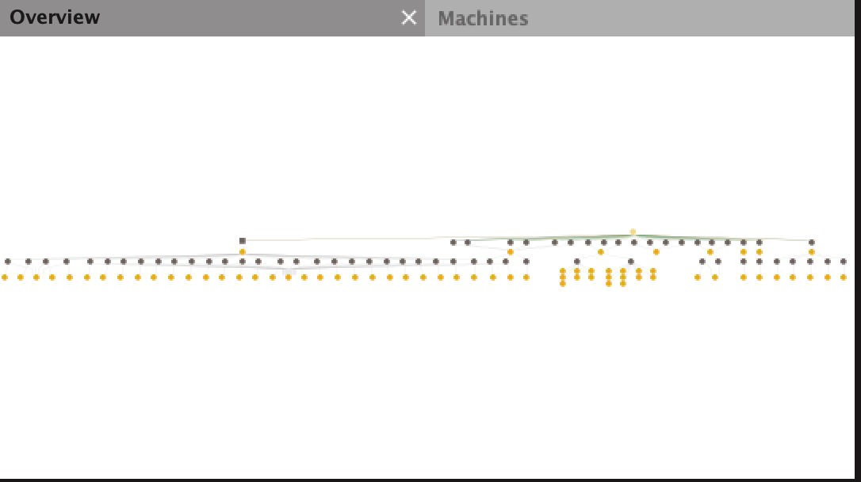
Where Does The Money Go?
Looking at outbound transactions, and going one layer deep, we can find more information about where the money is going.

Slide 28
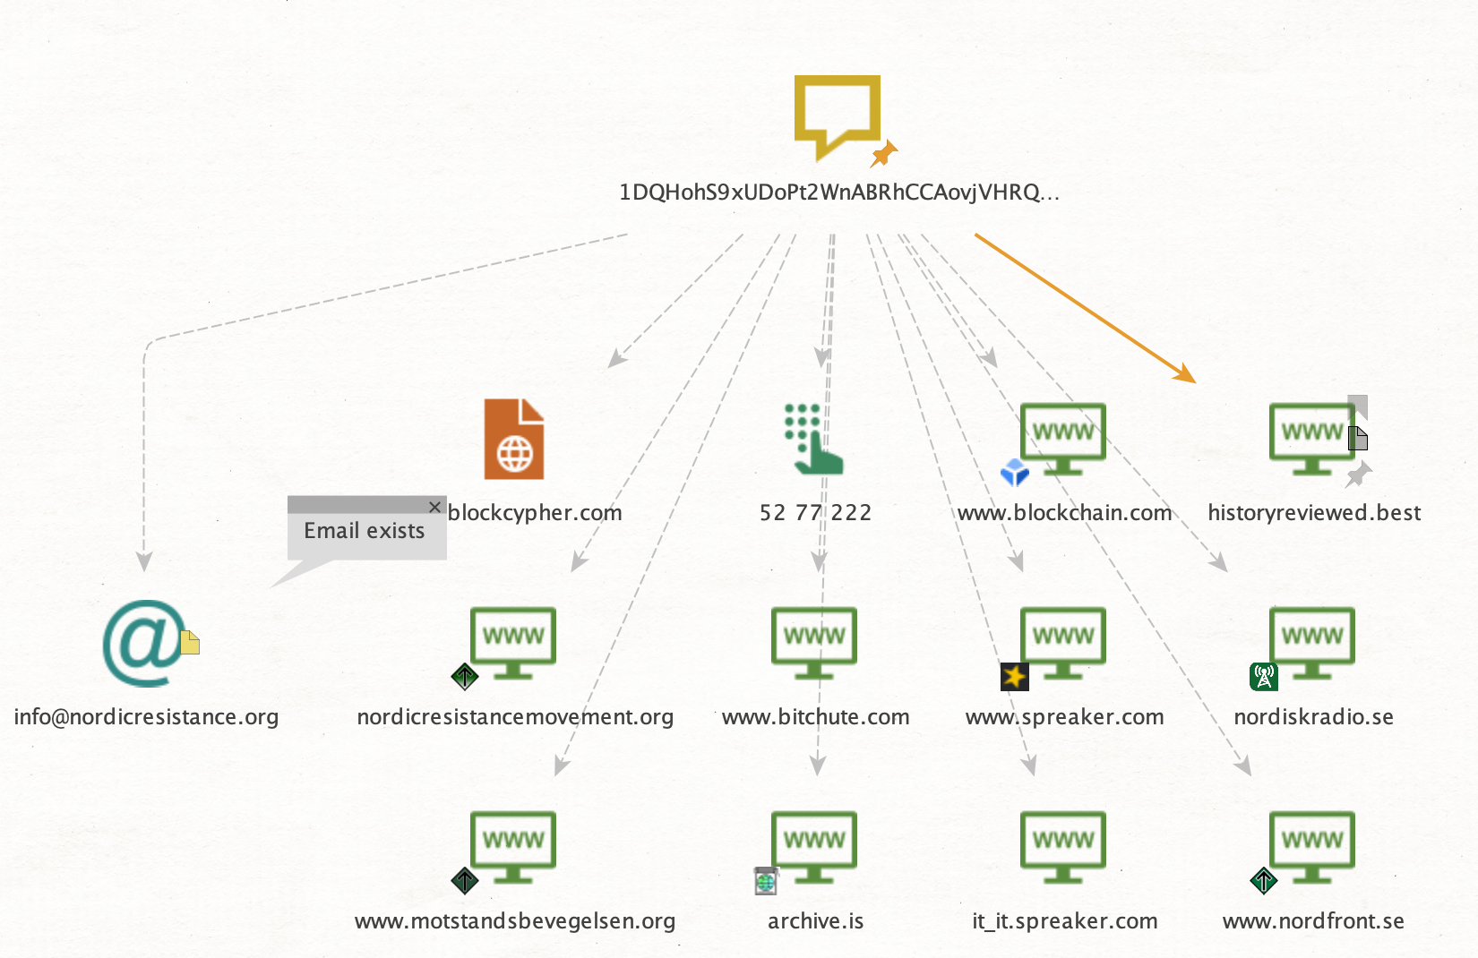
Identifying Fundraising Efforts
To identify where the wallet address is raising money, we can make a “phrase” entity, and pase the Bitcoin wallet address into it.
Here, we find media outlets of the organization raising money with the wallet ID.

Slide 29
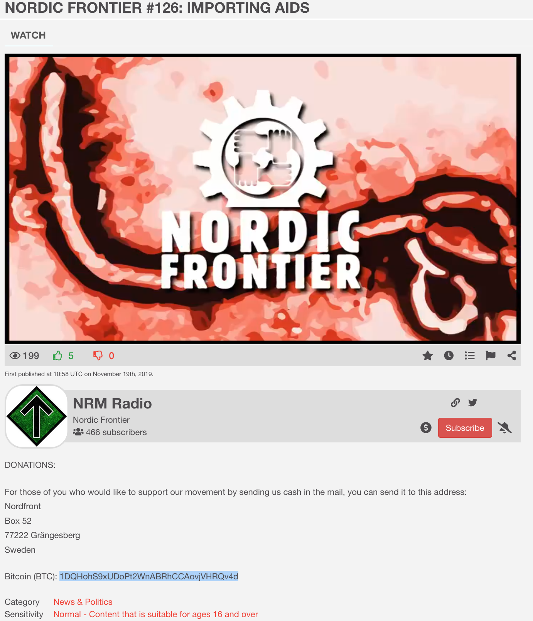
Identifying Social Channels
We have identified a media funding effort of the organization, this one calling for journalists to be hung on lamp posts.
We find an address we can use to find more information, and playlists full of their media content.
It also includes some social media handles we can use to further investigate.

Slide 30
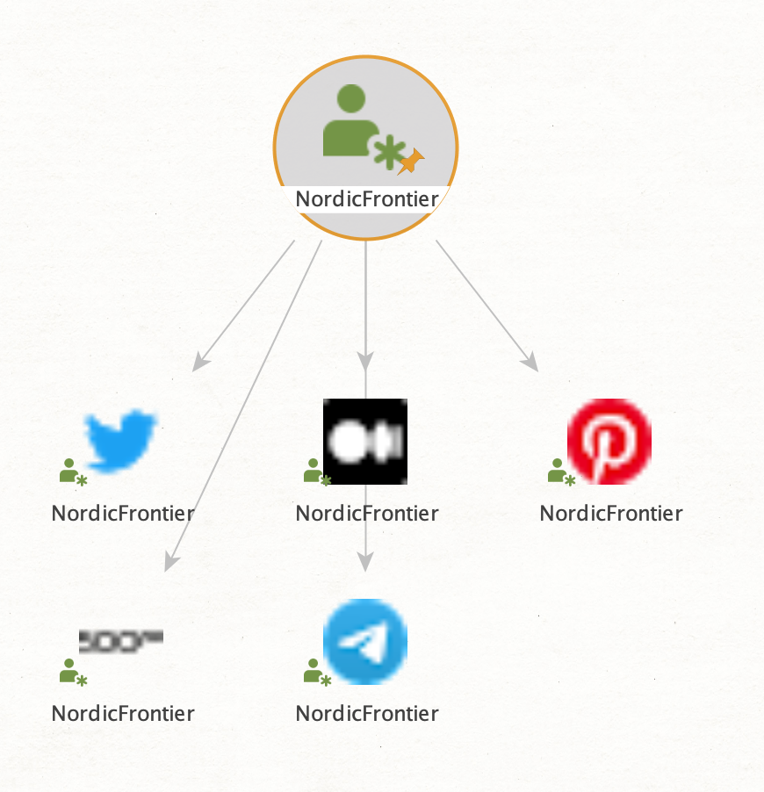
Locating Social Media Accounts
From the name of the media account, we create an “alias” entity, and run a search for social media accounts.
We find more social media accounts from the organization.

Slide 31
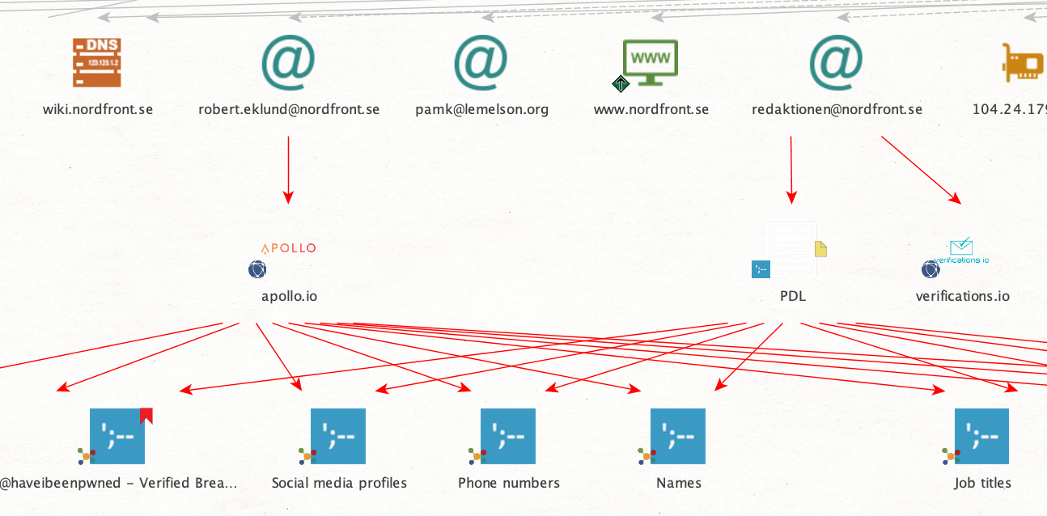
Finding Account Breaches
By using email addresses found from theHarvester, we can discover if any have been breached.
We can also find email addresses from the domain in Maltego.

Slide 32
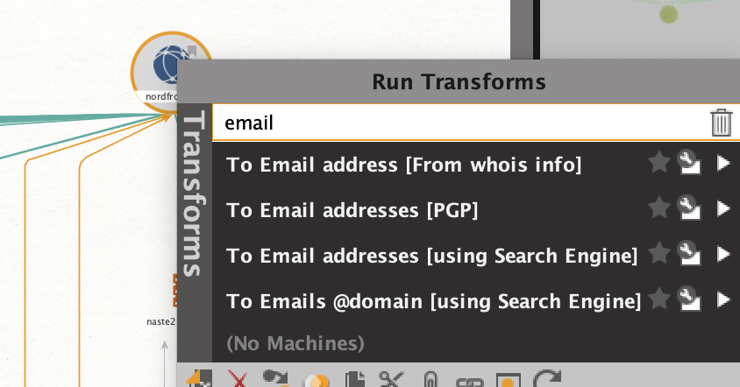
Identify Email Addresses
First, create a domain entity, and add the domain name of the target.
Using the “To Emails @domain” transform, identify other email addresses from the target domain.

Slide 33
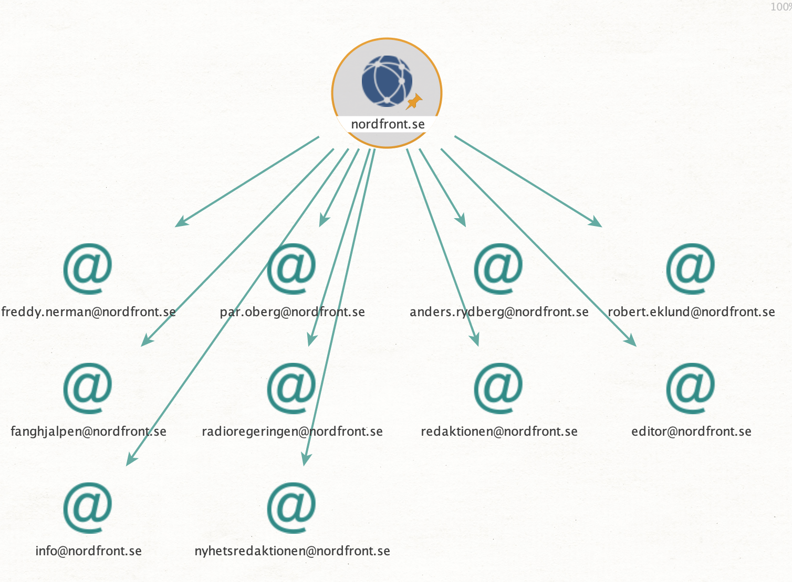
Look for Email Breaches
Select the discovered email addresses.
Then, run the “get all breaches of an email address” transform from “have I been pwned” transform set.

Slide 34
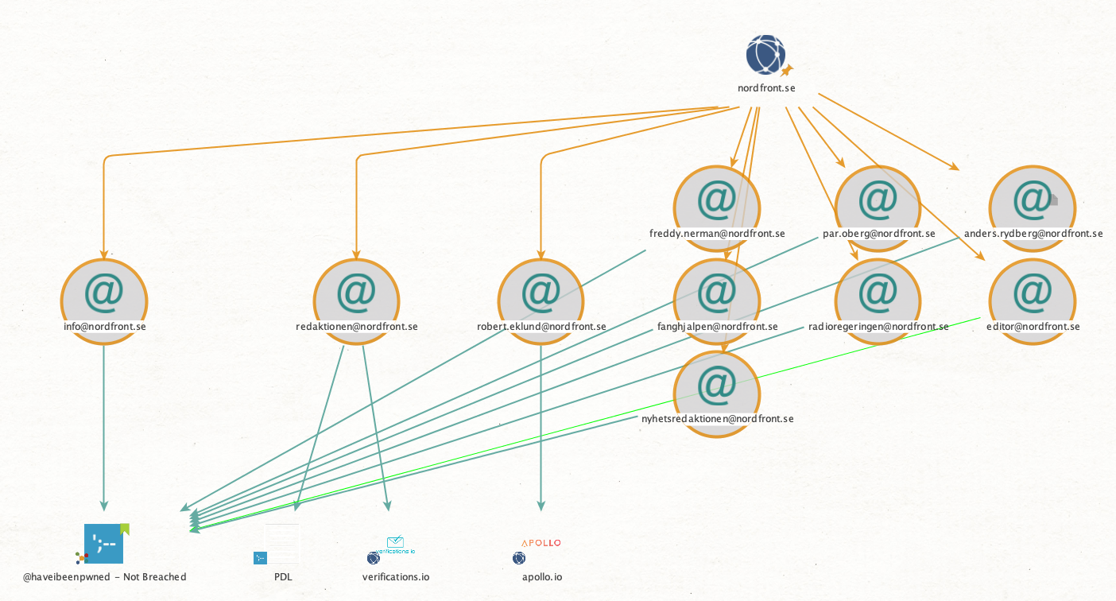
Sorting Through Results
If email addresses were not breached, they will point to a “not breached” entity.
If they are breached, the breach they were involved in will be shown on the screen

Slide 35
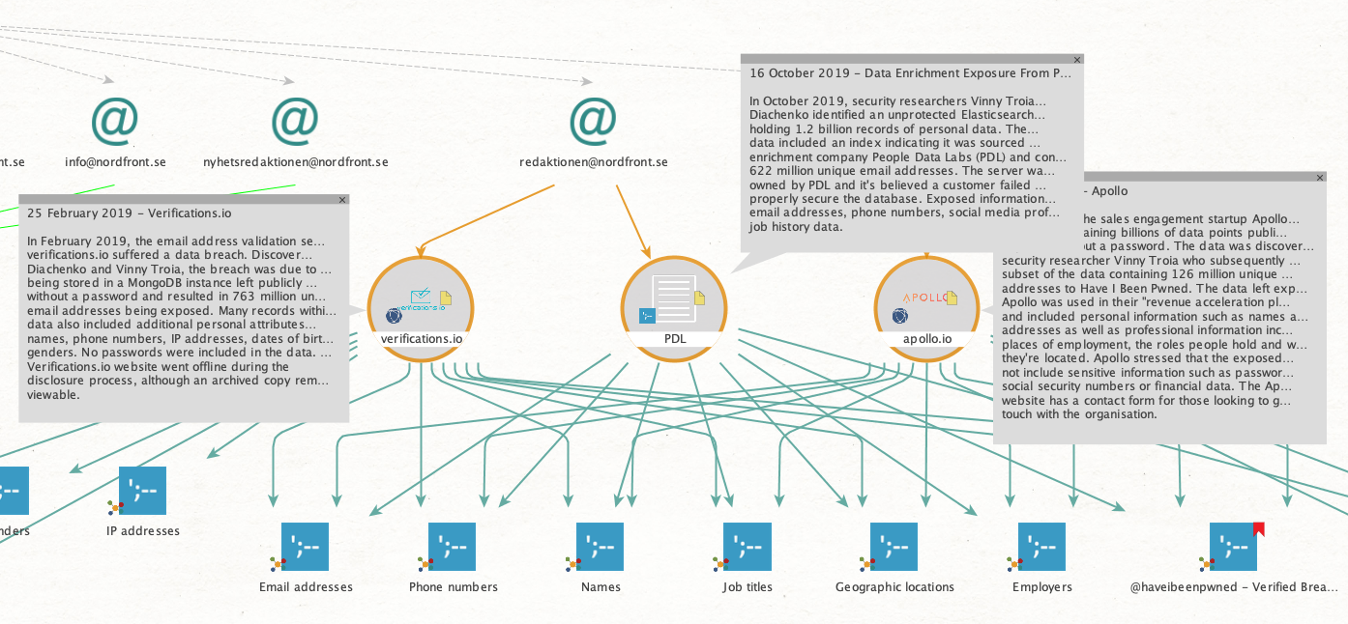
Enrich Breach Data

Slide 36
Practice!
I’ve given some examples of how to identify email addresses associated with an organization, and how to identify data breaches. Can you:
Identify other email addresses at a target organization?
Find an email account that has been breached on that list?
Find an account breach that involved passwords?
As a bonus:
Locate a business accepting payment to a Bitcoin wallet
Identify the total number of customers
Identify payments from the target wallet to other wallets

